Slide 1
Stanford's GSB
Instagram Strategy

Slide 2
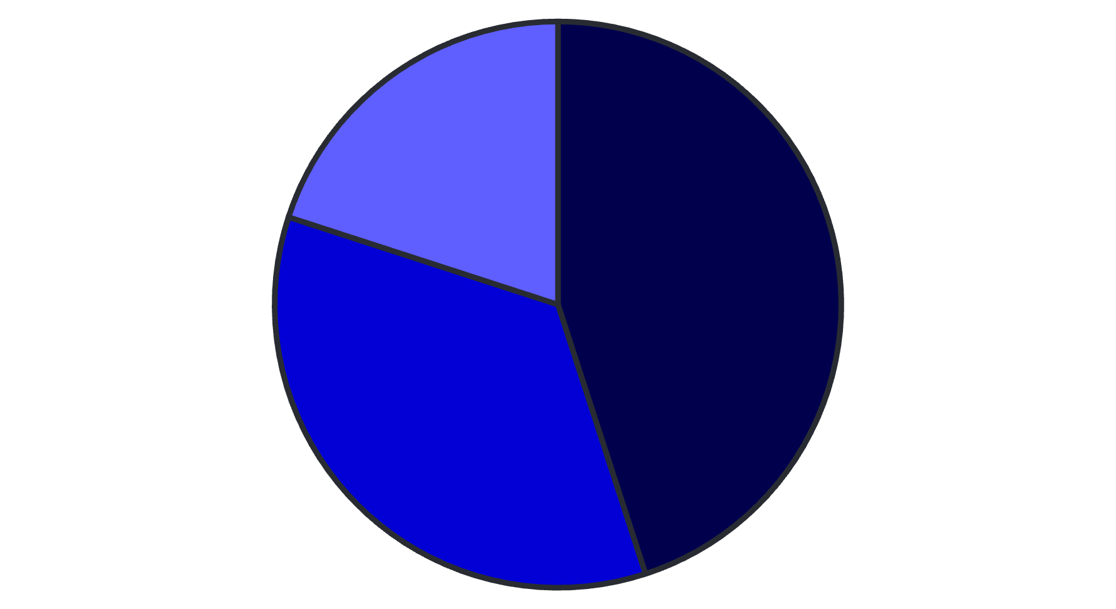
Current Instagram Performance
Single Images
Carousels
Reels
202K followers, 1,537 posts, 1.5% engagement rate

Slide 3
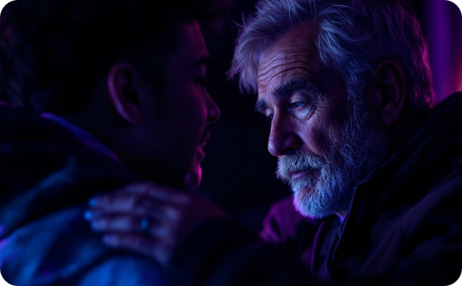
High-Performing Content
Emotional Storytelling
Community Highlights
Educational Content
Dipesh Mahtani's MS story gained high engagement
Student relationship reels received high viewership
Business insights generate consistent engagement

Slide 4
Strategic Objectives
Enhance Brand
15% follower growth in 6 months
Boost Engagement
Reach 2% average engagement rate
Strengthen Community
Monthly student/alumni stories

Slide 5
Content Strategy Pillars
Authentic Storytelling
Real experiences from students and alumni
Educational Insights
Digestible business concepts
Community Engagement
Monthly Q&A sessions via Stories
Event Highlights
Recaps and behind-the-scenes content

Slide 6
Proposed Content Calendar
1
Week 1
Student Life Carousel
2
Week 2
Alumni Spotlight Reel
3
Week 3
Faculty Insights Image
4
Week 4
Event Recap Stories

Slide 7
Performance Metrics Tracking
Follower Growth
Engagement Rate
Track monthly increases
Monitor likes, comments, shares
Reach & Impressions
Assess content visibility

Slide 8
Team Roles & Responsibilities
Strategy Lead
Oversees direction
Content Creator
Develops and schedules posts
Community Manager
Engages with followers
Analyst
Monitors metrics

Slide 9
Budget Allocation
Content Creation Tools
30% of budget
Promotions & Ads
50% of budget
Training & Development
20% of budget

Slide 10
Next Steps
Finalize Content Calendar
Set themes for next quarter
Implement Analytics Tools
Integrate Sprout Social
Conduct Training
Enhance team skills

