Slide 1
Consensus Social Media Strategy (2024-2025)
A comprehensive approach to building brand authority, driving engagement, and generating leads across key platforms for Consensus Cloud Solutions.

Slide 2
Company Summary & Brand Positioning
Industry Focus
Healthcare Interoperability, Cloud Faxing, NLP/AI, and Secure Data Exchange solutions.
Target Markets
Healthcare, Finance, Legal, Government, Education, and Real Estate sectors.
Core Value Proposition
"We simplify how vital industries exchange and act on information through secure, intelligent interoperability solutions."
Brand Tone
Professional, trustworthy, tech-forward, and regulation-aware.

Slide 3
Strategic Objectives
Build Brand Trust
Establish authority in healthcare IT for compliance-heavy buyers who need reliability.
Increase Platform Awareness
Target CIOs, administrators, and providers who are key decision-makers.
Drive Demo Requests
Focus on nurture-driven marketing for high-ticket, long sales cycles.
Humanize the Brand
Showcase real-world value through thought leadership and use cases.

Slide 4
Audience Breakdown
Segment
Role
Platform Focus
Healthcare CIOs
Decision-makers
LinkedIn, YouTube, Email
Compliance Officers
Risk and data stewards
LinkedIn, Whitepapers
IT Admins
End users of fax + API solutions
LinkedIn, Reddit, Product Hunt
Business Leaders
Strategic buyers
LinkedIn, Twitter/X
Clinicians (secondary)
User experience advocates
YouTube Shorts, Instagram

Slide 5
Content Pillars
Customer Success
Education
Case studies with large hospitals, before/after visuals
"What is Cloud Fax?", "How NLP helps unlock patient data"
Product Demos
Quick UI tours of eSignature tools, Direct Messaging, API interfaces
Culture & Trust
Compliance wins, awards, company moments, employee spotlights
Thought Leadership
CEO & experts on health equity, data access, HITRUST

Slide 6
Sample Monthly Content Calendar
Week 1
1
LinkedIn: HIPAA-compliant eFax explainer
YouTube: "NLP in 60 sec"
Week 2
Twitter: Thread on Interop in US healthcare
2
Instagram: Office culture clip
LinkedIn: Case study on Improved ROI with RPA
YouTube: Quick demo of Secure Direct Messaging
Twitter: CEO quote + blog link
Week 3
3
Instagram: Infographic
LinkedIn: Carousel on Cloud Fax vs. Traditional
YouTube: Healthcare API overview
Twitter: Event promo
4
Week 4
Instagram: Behind-the-scenes
LinkedIn: Award/Achievement
YouTube: "1 API. 100+ endpoints" short
Twitter: Stats + Healthcare Data Week thread
Instagram: Compliance win post

Slide 7
Competitor Analysis
Updox
Kno2
Verisma
Consensus (today)
Strengths: Strong provider branding, effective use of customer faces in marketing.
Strengths: Niche messaging for data liquidity in healthcare.
Strengths: HIPAA-first positioning and effective storytelling.
Strengths: Trusted tone, clear offerings in marketing.
Our Focus: Emphasize broader product suite and better UX.
Our Focus: Human-centered content on secure collaboration.
Our Focus: Add more visuals, short-form demos, and founder voice.
Our Focus: Lean into hospital/clinic use cases with real people.

Slide 8
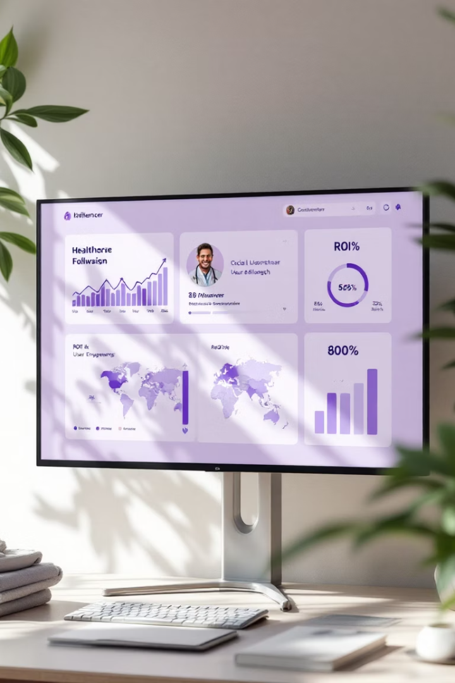
Paid Social & Influencer Strategy
Healthcare has a longer sales cycle. Decision-makers are busy—paid ensures top-funnel visibility.
4
3x
Key Platforms
Visibility Goal
LinkedIn, Twitter, YouTube, and Meta for targeted campaigns.
Increase brand awareness through educational boosting.
2
Influencer Tactics
Health IT creators and joint webinars with hospital CIOs.

Slide 9
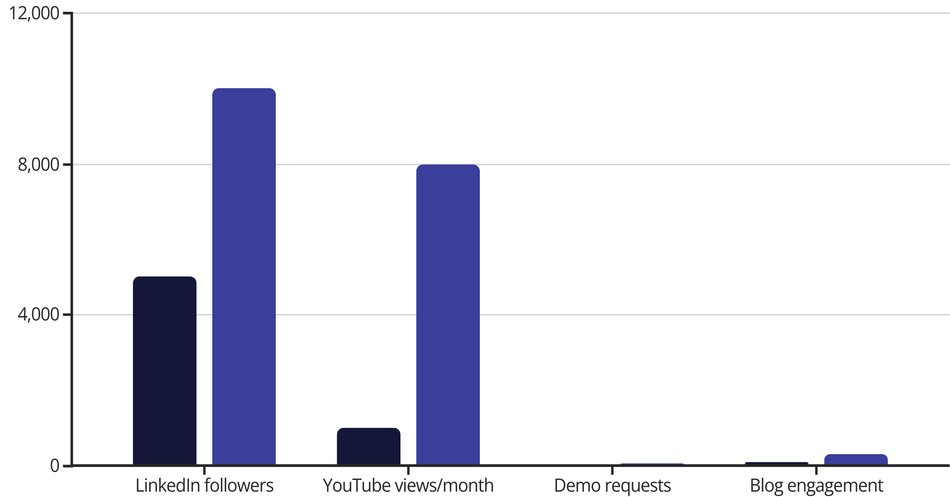
KPIs & Growth Metrics
Current
Goal
Track performance using UTM + HubSpot/Marketo, Sprout Social, LinkedIn Campaign Manager, and Google Analytics 4.

Slide 10
Platform-by-Platform Focus
LinkedIn
Main platform for trust and B2B buyers. Focus on carousels, case studies, and team thought leadership.
YouTube
Great for video demos and searchability. Create feature explainers and 60-second overviews.
Twitter/X
Tap into health policy, IT news, and HIT hashtags with threads and trending reactions.
Instagram
Secondary platform for human element. Share culture, conferences, and awards.
Email
Support channel for gated content follow-up and product launch alerts.

